Slide 1

APEX: A Framework for Smarter Problem Solving
Assess – Plan – Execute – eXamine

Slide 2
What Is a Problem-Solving Framework?
A problem-solving framework is like a mental map. It gives you a clear, repeatable path to follow when you're faced with a tough question or situation.
The APEX Framework is a simple, four-step process that trains you to think clearly, act intentionally, and reflect on your results.

Slide 3
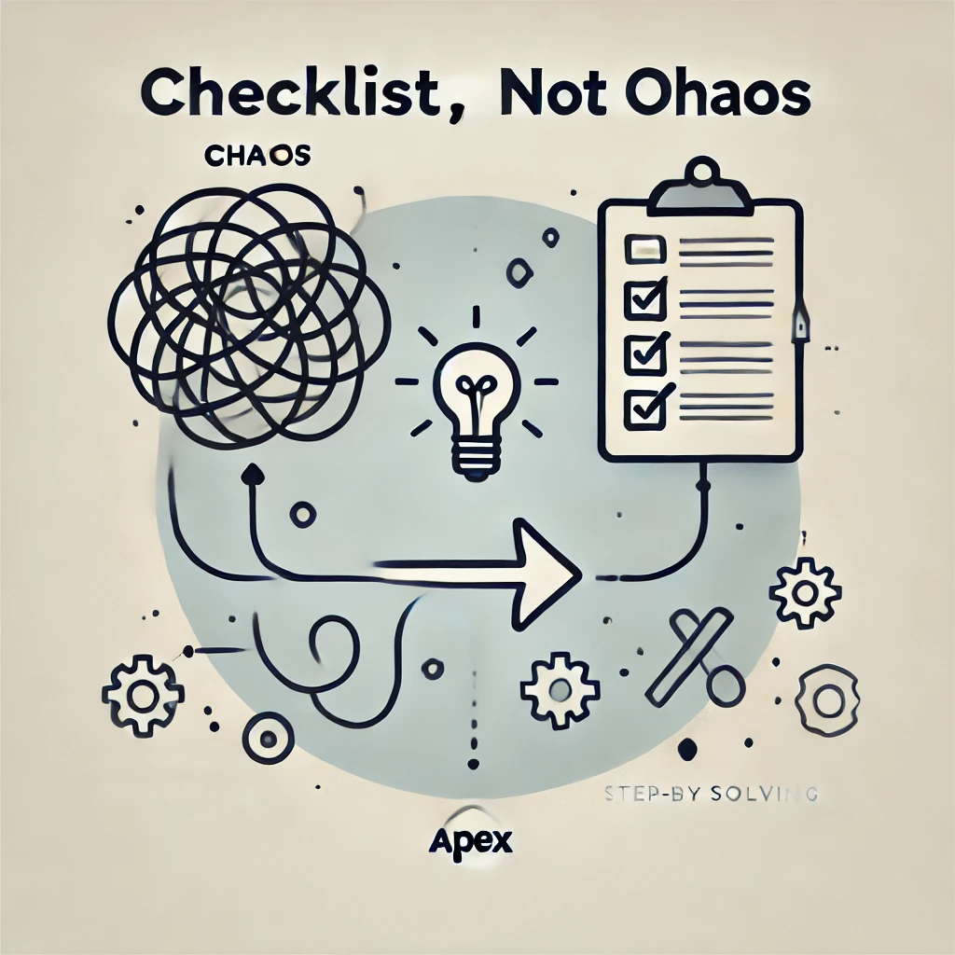
Why Use a Framework?
Life and school are full of problems.
APEX helps break complex problems into manageable steps.
Following the right order avoids costly mistakes.
Think: checklist, not chaos.

Slide 4
What Does APEX Stand For?
Step | What It Means | Think of it like...
Assess | What do I know? What am I solving? | Situation report
Plan | What tools and steps will I use? | Game plan
Execute | Carry out the plan | Action time
eXamine | Check the result: Does it make sense? | Debrief & debug

Slide 5

A Real-Life Example: The Snake and the Hiker
Assess – Danger level? Victim's condition?
Plan – Find a stick, call for help, remove the snake.
Execute – Carefully put the plan into motion.
eXamine – Did it work? Is help coming? Is the hiker okay?

Slide 6

Why It Works
APEX isn’t just a physics tool — it’s a way of thinking that works in all parts of life.
Problems can feel overwhelming until you break them down.
APEX gives you structure and confidence to move forward.
Use it when you’re stuck, uncertain, or facing a tough decision.

Slide 7

Assess – Plan – Execute – eXamine

